Slide 1

Cartoonizing Image
Team Members:
Shaik. Gouse Mastan Vali (17471A0502)
D. Krishna Vamsi (17471A0552)
A. Sairam (17471A0555)
K. Lakshmi Narayana (17471A0542)
Project Guide:
Mr .P.Lakshmi Narayana M.Tech
Assistant Professor

Slide 2
Abstract
This project will help the anyone to cartoonize the picture easily.
In this project, we propose an implementation of white box representation and GAN (Generative Adversarial Network) using a convolution neural network

Slide 3
Introduction
Animation pictures assume basic parts in our regular day to day existences particularly in promotion, games, tv series etc.
Now a days lots of American, Japanese, chines are launching different type of movies on cartoon characters.
Here we are using three white box representations namely surface representation, structure representation, texture representation
GAN is using to extract the representations and to cartoonize the images

Slide 4
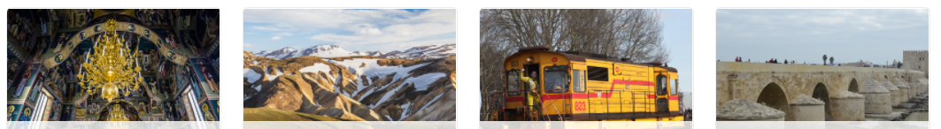
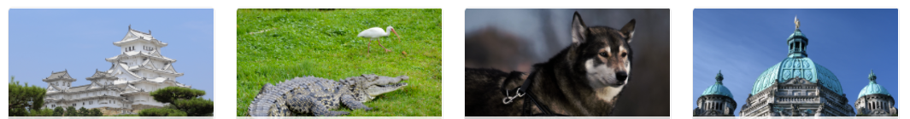
Dataset:
We use a publicly available dataset.
The contents of the collected images include male celebrities , female celebrities , animals , plants , food natural sceneries , city views , and other objects.
All the images of person are from CelebA dataset while the rest of images are from the DIV2K dataset from Kaggle
And thousands of images collected from Microsoft COCO dataset
Ex:

Slide 5
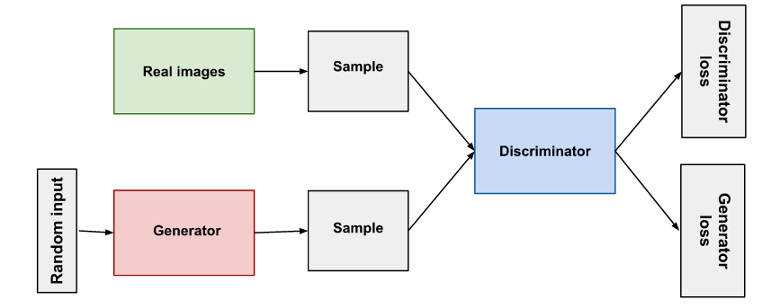
Algorithm Used:
GAN(Generative Adversarial Network)
GAN has been widely used in conditional image generation tasks, such as image inpainting , style transfer , image cartoonization, image colorization
GAN’s most advanced method of neural networks. In this we are having two main neural networks that is generator and discriminator. GAN’s networks mainly used for generate synthetic information or fake data .
here Generator main objective is to generate fake data from noise data .it is acts like DCNN network ,it will generate the images or text or videos
So, we can say that CNN is the one of the part of GAN’s network , where as GANs having both the networks CNN ad DCNN .

Slide 6
Algorithms Used:
CNN (Convolution Neural Network):
In neural networks, Convolutional neural network (ConvNets or CNNs) is one of the main categories to do images recognition, images classifications. Objects detections, recognition faces etc., are some of the areas where CNNs are widely used.
CNN image classifications takes an input image, process it and classify it under certain categories (Eg., Dog, Cat, Tiger, Lion). Computers sees an input image as array of pixels and it depends on the image resolution. Based on the image resolution, it will see h x w x d( h = Height, w = Width, d = Dimension ). Eg., An image of 6 x 6 x 3 array of matrix of RGB (3 refers to RGB values)

Slide 7
White Box Representation
Surface Representation: It helps to extract smooth surfaces of the image like edges, textures, and details.
Structure Representation: It helps to derive global structural information and sparse color blocks, once done we implement adaptive coloring algorithms that can help us to generate sparse visual effects
Textured Representation: It helps us to retain painted details and edges. The three-dimensional image is converted to single-channel intensity map that helps to retain pixel intensity compromising color and luminance, it follows the approach of manual artist that first draw a line sketch with contours and then apply colors to it.
The extracted outputs are fed to a Generative Neural Networks (GAN) framework, which helps to optimize our problem making the solution more flexible and diversified.

Slide 8
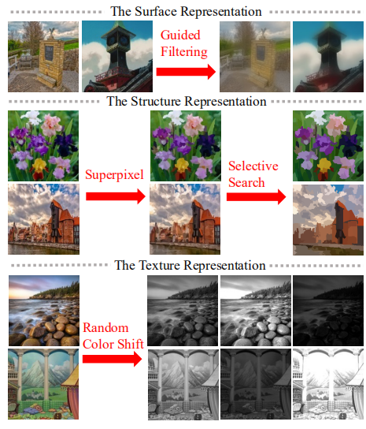
White box representation

Slide 9

Sample UI Pages:
Output UI:

Slide 10

Sample UI Pages:(contd..)
Uploading the image

Slide 11
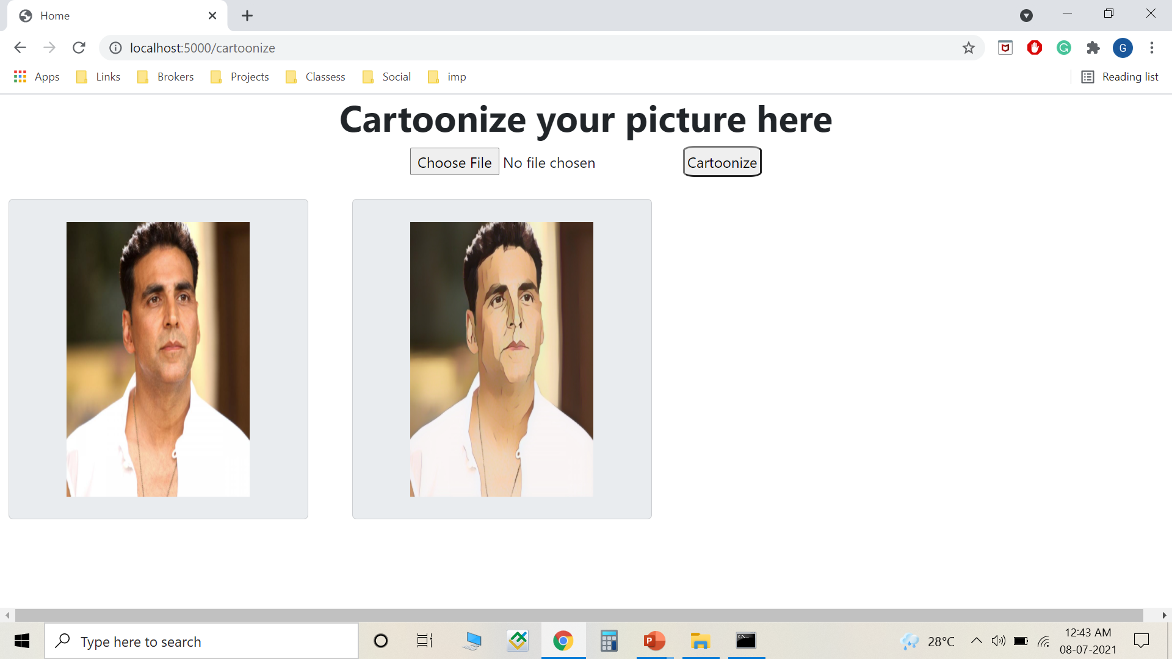
Test Cast UI Pages:
Classifying Cartoon Image:

Slide 12
Future Enhancement:
We will upgrade this project to cartoonize videos
This project will also be implemented in mobile phones to capture the live video and can immediately shows the live cartoon

Slide 13
Conclusion:
Finally, the user can be able to cartoonize any picture easily
There will be no issue with the cartoonized image quality and no delay in producing the cartoon picture

Slide 14

Thank you!!

